Slide 1
Fundamental Algorithms I
Linden Lu

Slide 2
Fundamental Algorithms I
Linear Regression
Logistic Regression
Decision Tree

Slide 3
Module Objectives
By the end of this module, you will be able to:
Understand how the three algorithms work.
Apply the three algorithms with Python code.
Understand the key model hyperparameters.
Understand basic model evaluation metrics.

Slide 4
Introduction to Linear Regression
Linden Lu

Slide 5
Linear Regression
Supervised learning
Predict continuous output
Assume linear relationships between input and output
Feature scaling is normally not needed

Slide 6
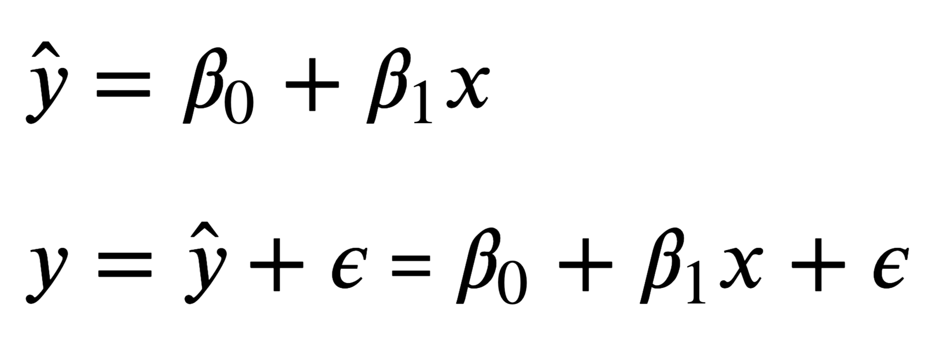
Simple Linear Regression

Slide 7
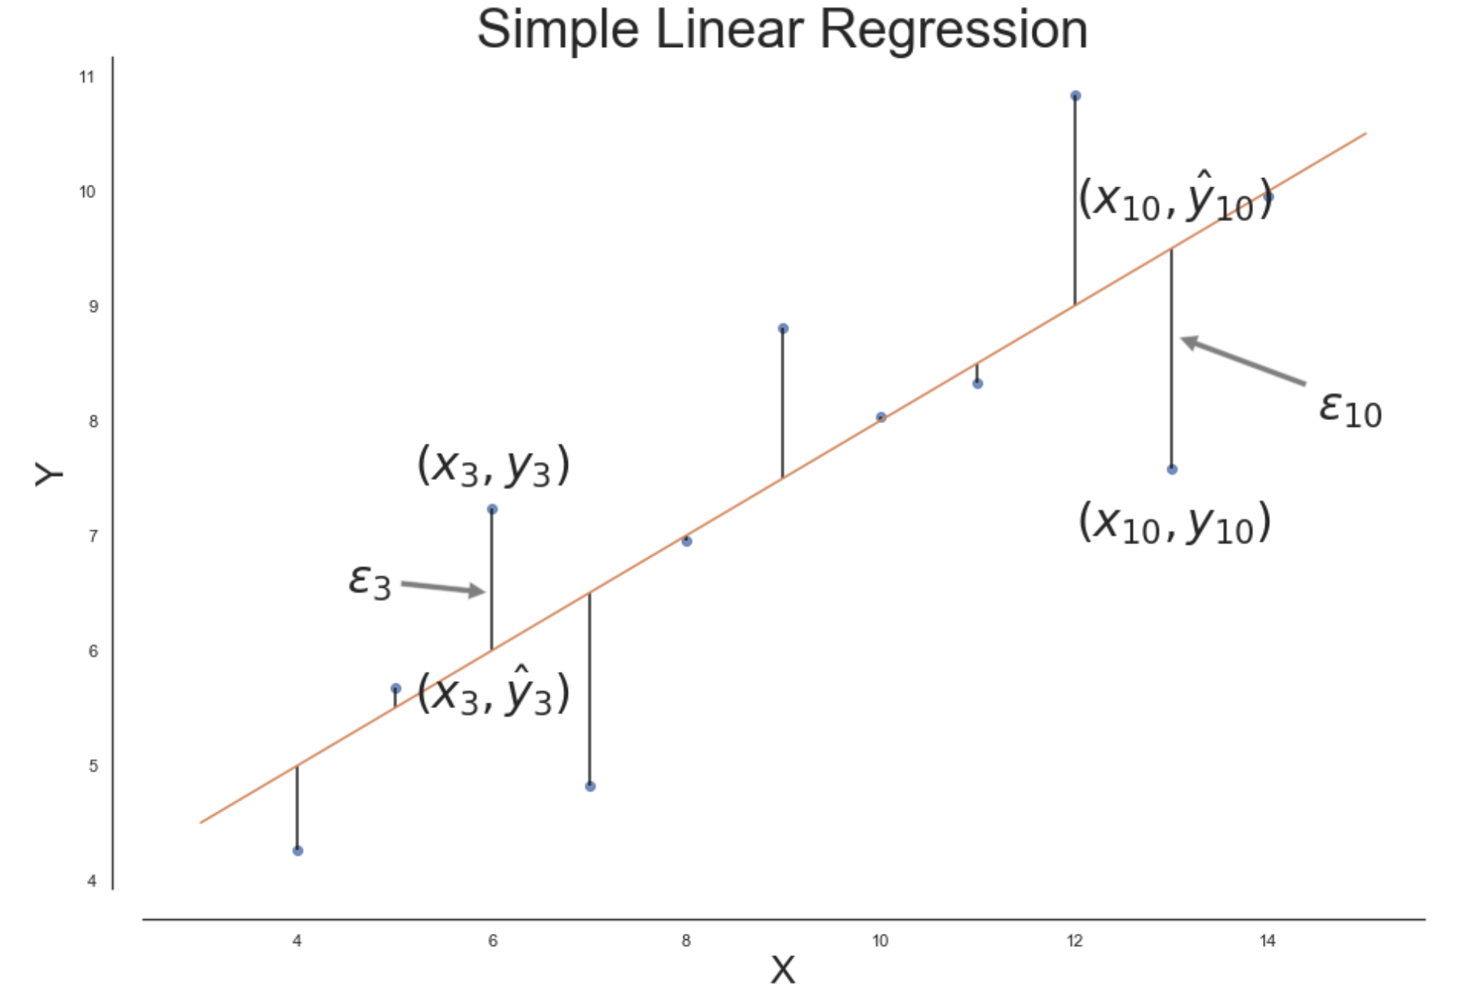
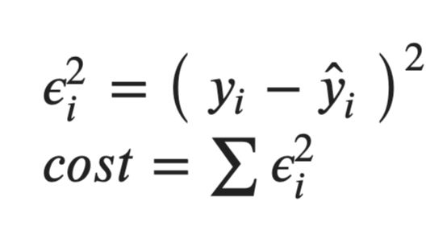
Cost Function

Slide 8
Tips Dataset
 | total_bill | tip | gender | smoker | day | time | size
85 | 34.83 | 5.17 | Female | No | Thurs | Lunch | 4
54 | 25.56 | 4.34 | Male | No | Sun | Dinner | 4
126 | 8.52 | 1.48 | Male | No | Thurs | Lunch | 2
93 | 16.32 | 4.30 | Female | Yes | Fri | Dinner | 2
113 | 23.95 | 2.55 | Male | No | Sun | Dinner | 2

Slide 9
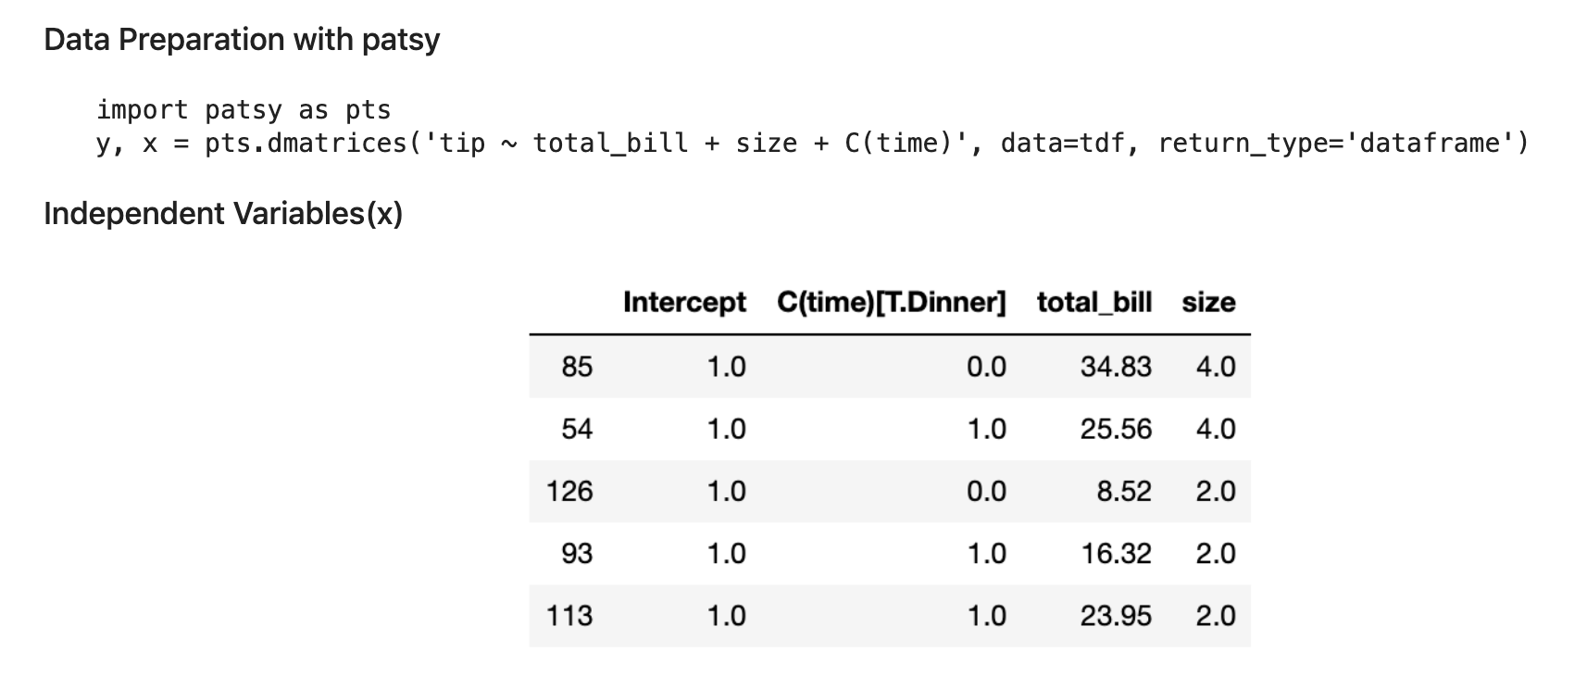
Data Preparation

Slide 10
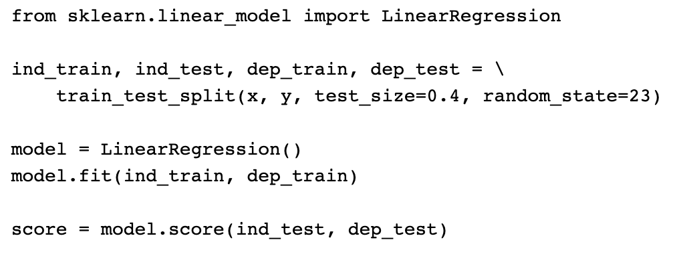
Scikit Learn LinearRegression Model

Slide 11
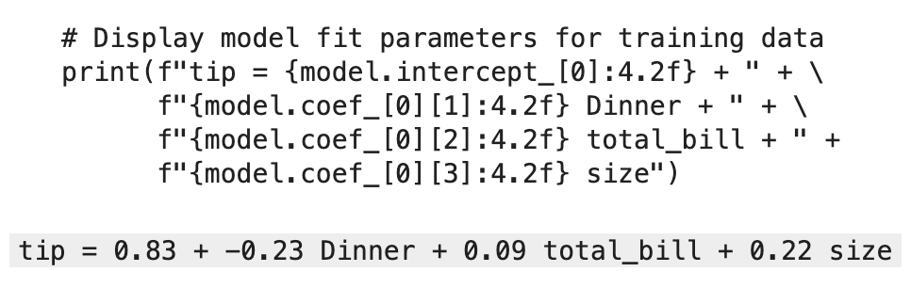
Linear Regression Formula

Slide 12
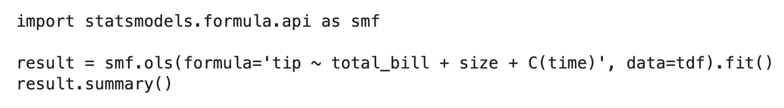
Statsmodels Linear Regression

Slide 13
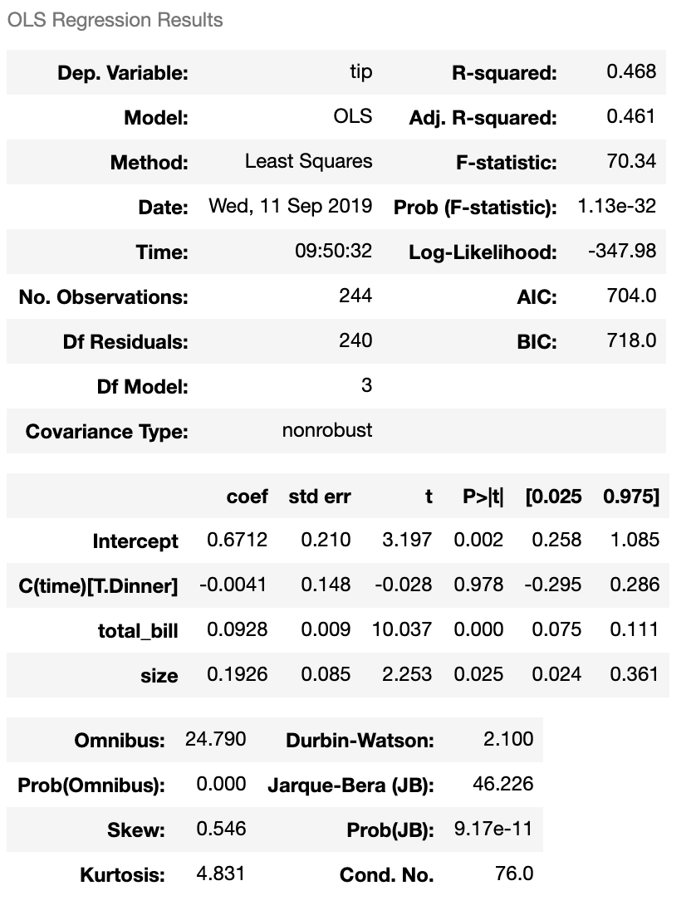
Linear Regression Result

Slide 14
Introduction to Logistic Regression
Linden Lu

Slide 15
Logistic Regression
Supervised learning
For classification problems
Feature scaling not needed

Slide 16
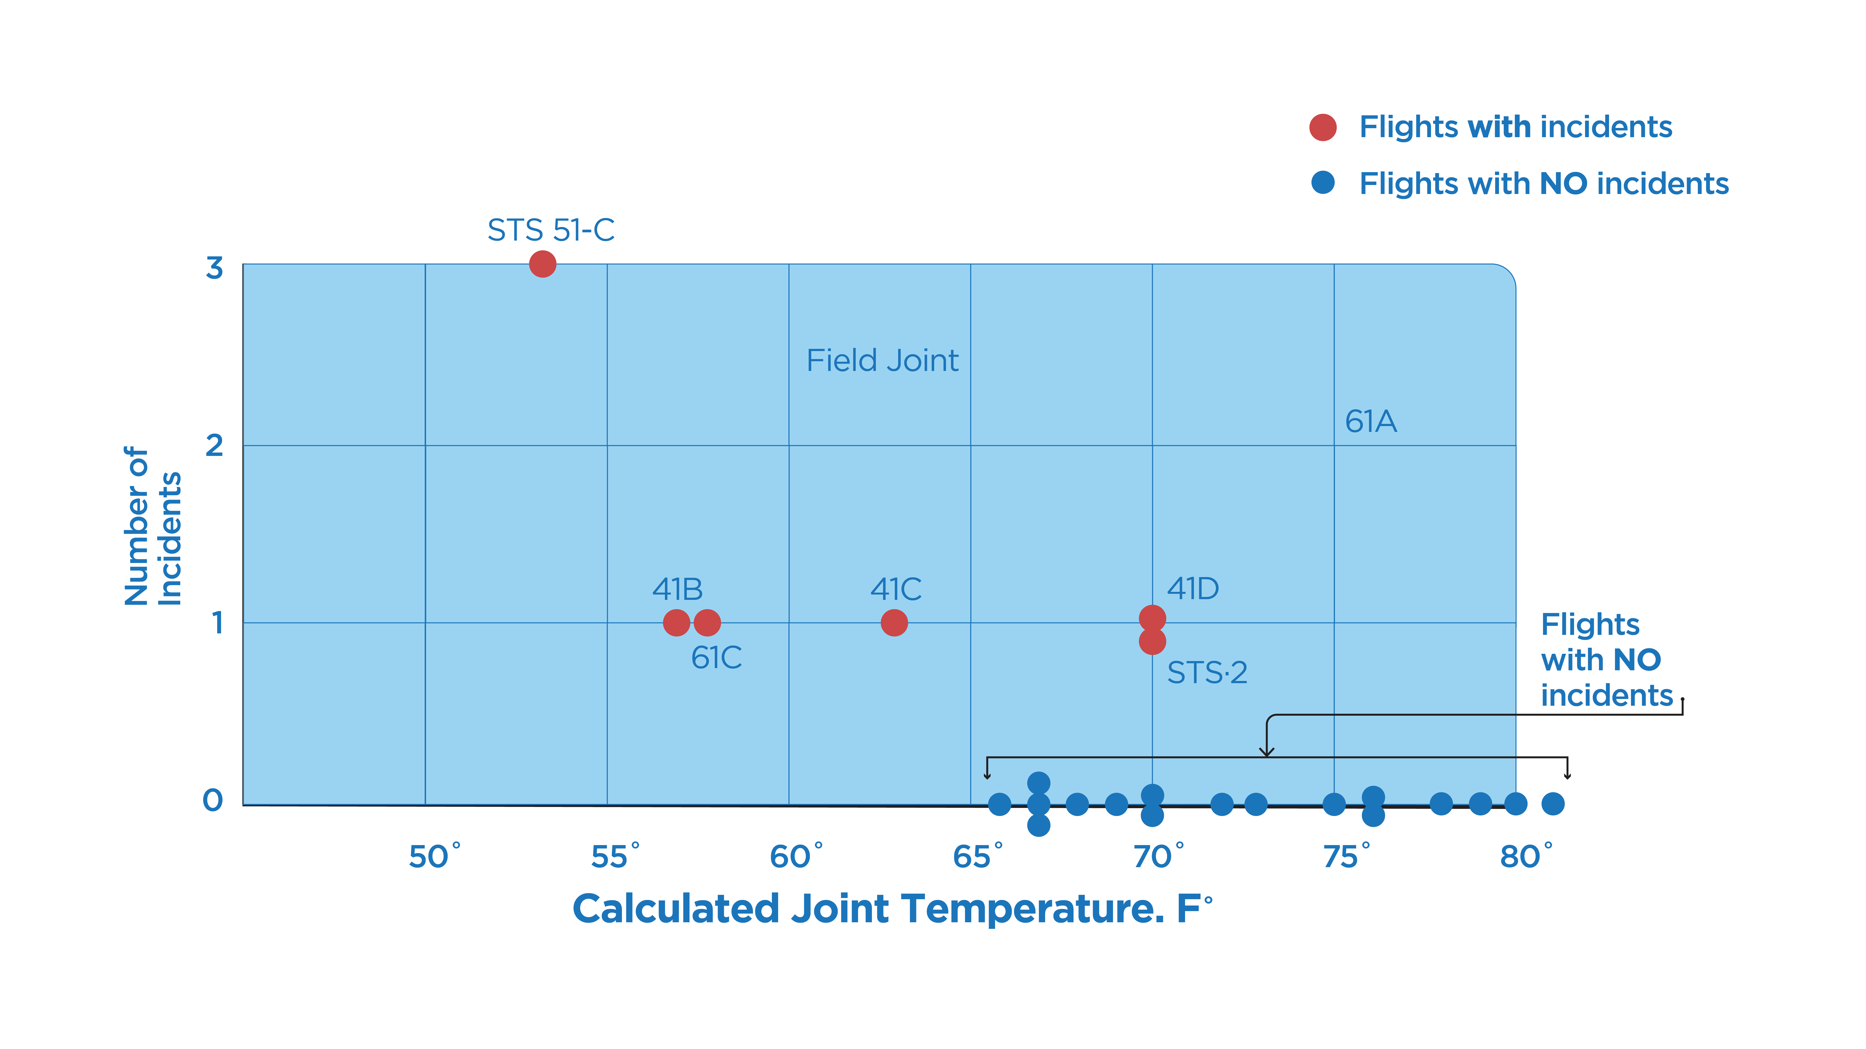
Challenger Disaster Investigation

Slide 17
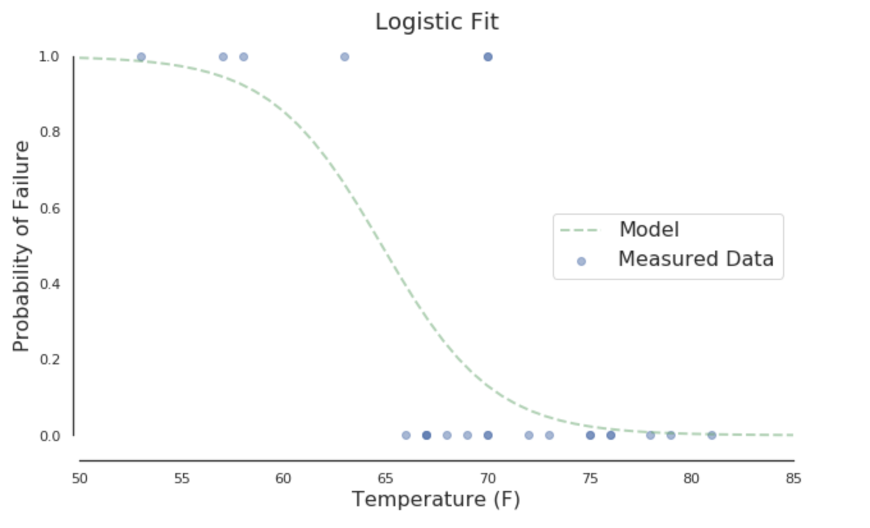
Map to Probability

Slide 18
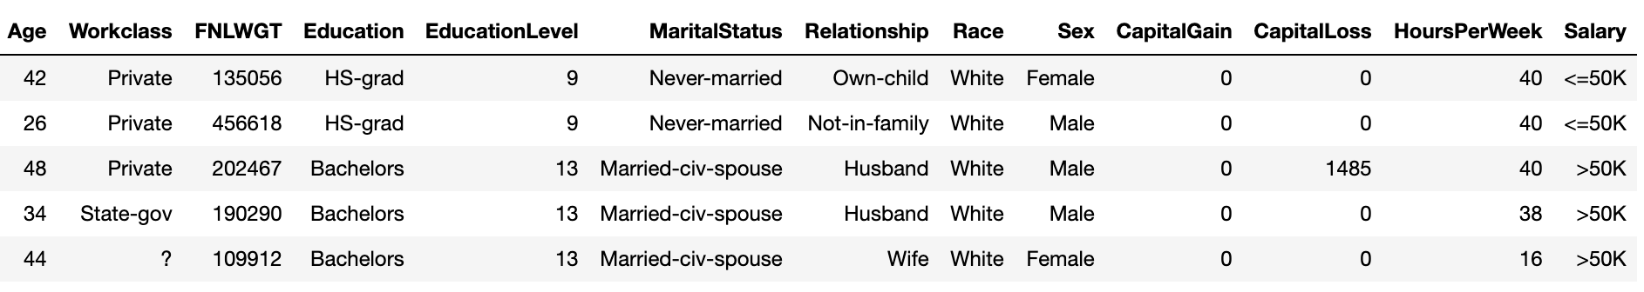
Adult Income Dataset

Slide 19
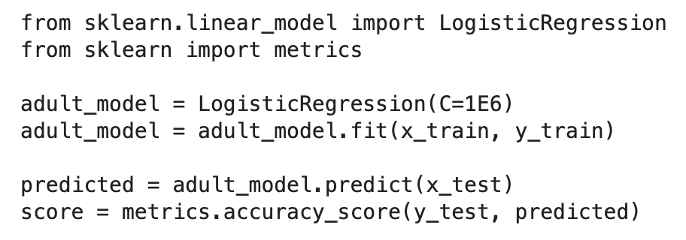
Scikit Learn LogisticRegression Model

Slide 20
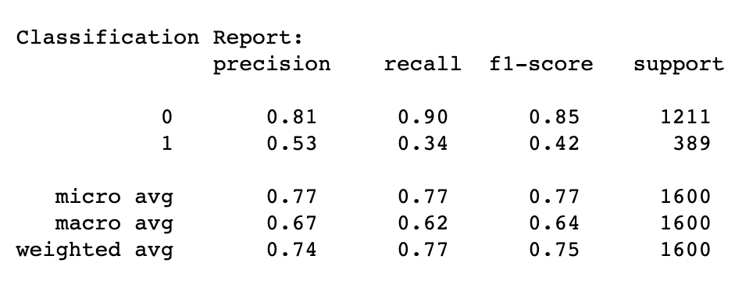
Classification Report

Slide 21
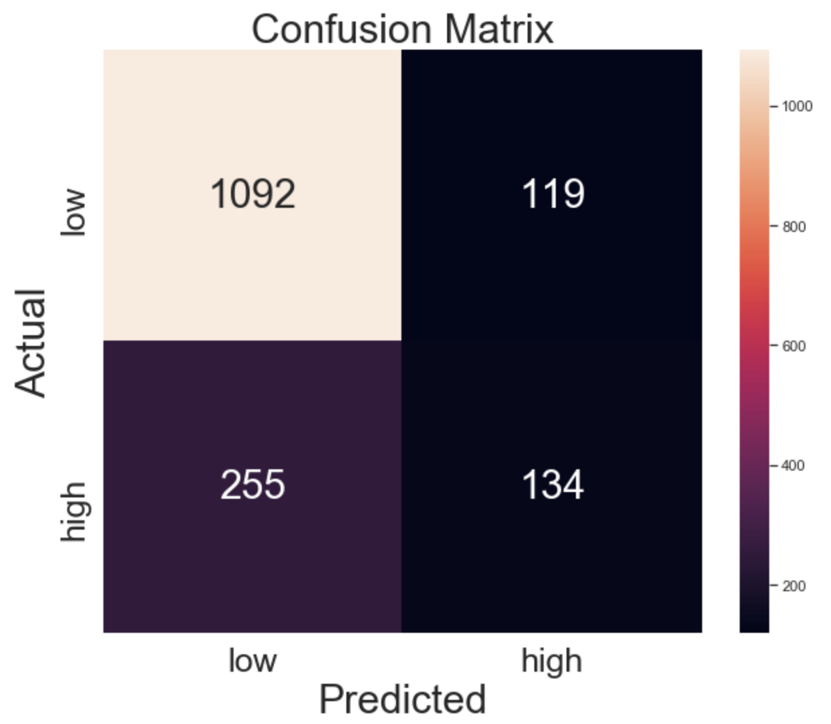
Confusion Matrix

Slide 22
Introduction to Decision Tree
Linden Lu

Slide 23
Decision Tree
Supervised learning
For both classification and regression problems
Can handle categorical feature (numerical)
Feature scaling is not needed

Slide 24
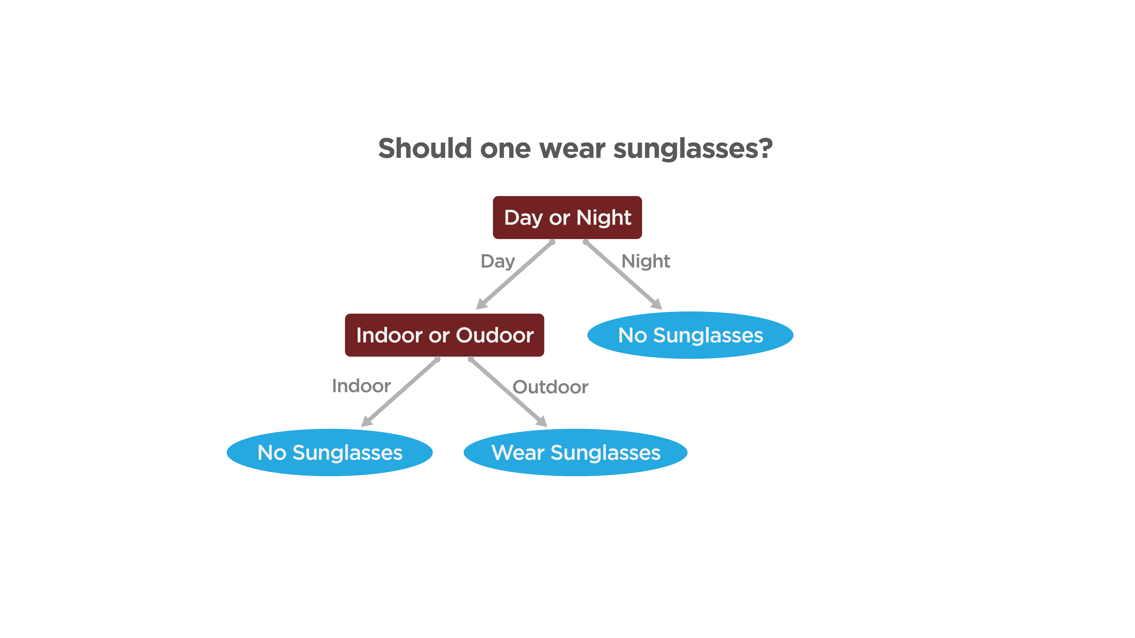
Decision Tree

Slide 25
Iris Dataset
 | sepal_length | sepal_width | petal_length | petal_width | species
25 | 5.0 | 3.0 | 1.6 | 0.2 | setosa
127 | 6.1 | 3.0 | 4.9 | 1.8 | virginica
16 | 5.4 | 3.9 | 1.3 | 0.4 | setosa
105 | 7.6 | 3.0 | 6.6 | 2.1 | virginica
102 | 7.1 | 3.0 | 5.9 | 2.1 | versicolor

Slide 26
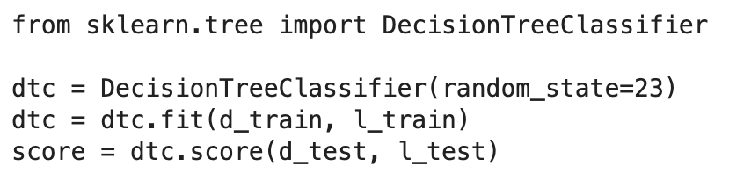
Scikit Learn Decision Tree Classifier

Slide 27
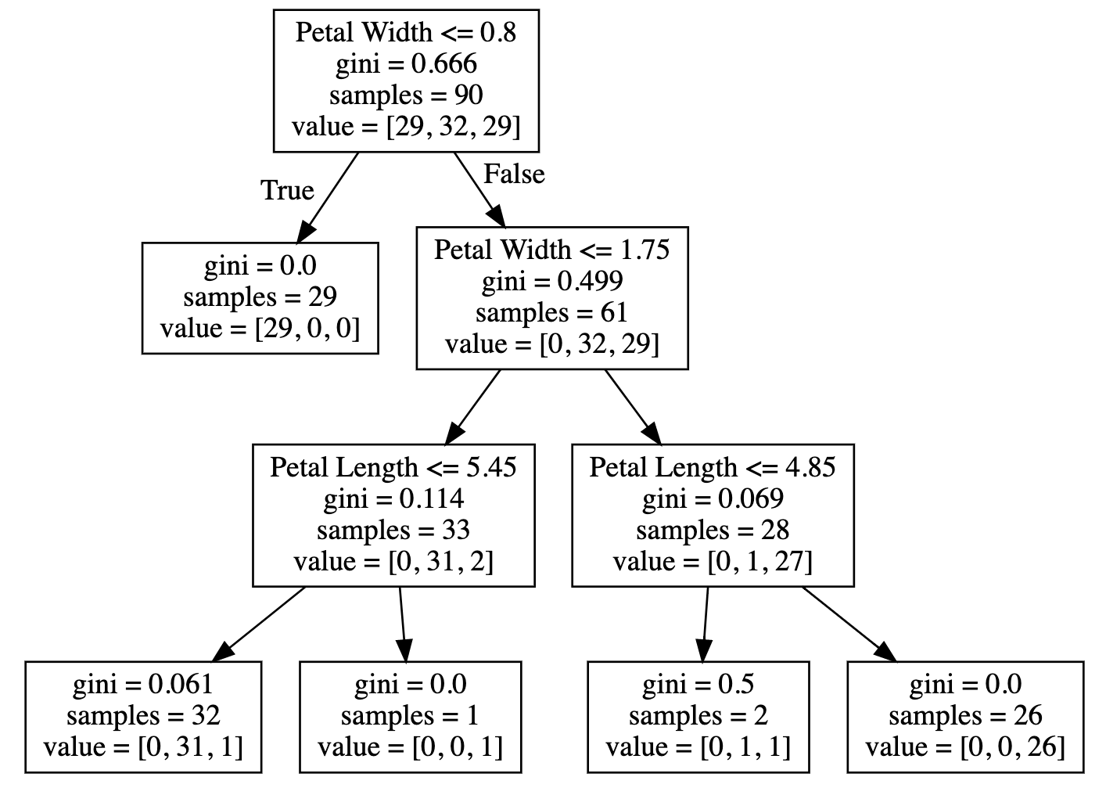
Visualize Decision Tree

Slide 28
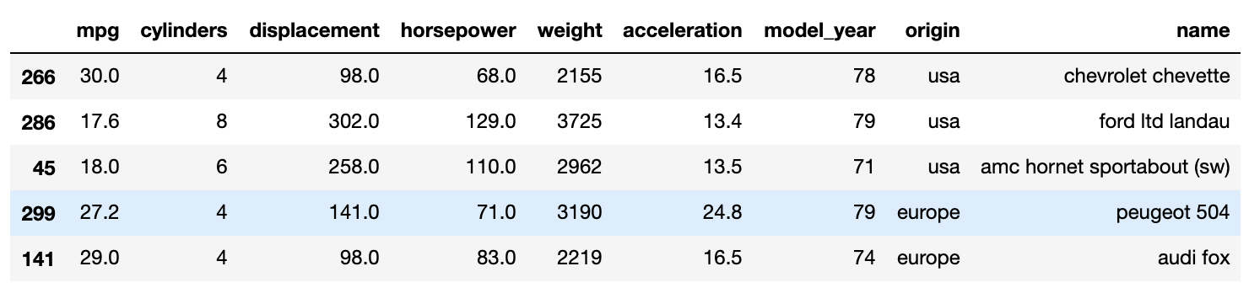
Auto MPG Dataset

Slide 29
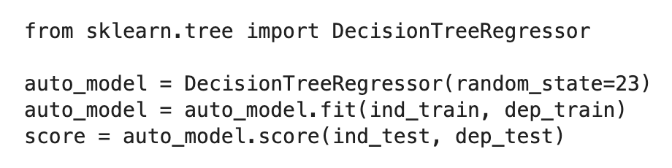
Scikit Learn Decision Tree Regressor

Slide 30
Review
Linear Regression
Logistic Regression
Decision Tree

Slide 31
Review
Continuous Features
Scaling not needed
Categorical Features
Create dummy variables
Linear regression
Logistic regression
Label encoding
Decision tree

